Slide 1
Azure Solution Alignment Workshop
Azure network security

Slide 2
High-level agenda
Identify current network security strategies and environments
Azure network security overview and security models
Network Security Groups
Use-defined routing
Virtual Appliances
Web Application Firewall
Internet access
Forced tunneling
Public peering
Control plane versus data plane logging
Next steps

Slide 3
Key Discussions and Decisions
Current network security strategies and implementations
Current containment and segmentation strategies
Number of existing security zones and how is data flow isolated between them?
Existing security stacks
Virtual appliances used
Force tunneling model
Firewall requirements?
Web traffic, non-web traffic inspection?
Notes:
CONSULTANT NOTES:
You can use this as an open conversation for to clearly identify what is the current state of their environment.
While there are many topics in this deck that are FYI, these are the fundamental questions that need to be answered.
Before delivering ALWAYS review the SOW to see what parts you have to deliver. Some SOWs will vary, so don’t deliver more than we promised at the beginning.
Don’t spend too long on this slide, as you need to deliver much of this deck for a solid overview of the Identity capabilities.
But, spend at least 20-30 minutes to begin to discover what they have in place already. Then elaborate more at that point in the deck or in side conversations afterwards.
This slide is also included at the end to use as a review to confirm you have a solid understanding of the current state versus what you need to help deliver for the engagement.

Slide 4
Azure network security

Slide 5
Public cloud is a shared responsibility
Traditional
IaaS
PaaS
SaaS
You manage
Applications
Applications
Applications
Applications
Data
You manage
Data
Data
Data
Runtime
Runtime
Runtime
Runtime
Managed by Microsoft
You manage
Middleware
Middleware
Middleware
Managed by Microsoft
Middleware
Operating System
Operating System Software Network
Managed by Microsoft
Operating System
Operating System
Virtualization
Virtualization
Virtualization
Virtualization
Servers
Servers
Servers
Servers
Storage
Storage
Storage
Storage
Physical Network
Physical Network
Physical Network
Physical Network
Windows Server
Windows Azure Virtual Machines
Windows Server Hyper-V
Windows Azure PaaS Services
Office 365
Dynamics CRM

Slide 6
Network protection
Network isolation
Virtual Networks
Cloud to on-premises connections
Segregates network access between customers, management systems & the internet
Connects cloud services using private IP addresses, subnets
Site-to-Site, Point-to-Site, and ExpressRoute help enable secure connect to Azure
6

Slide 7
Network isolation
INTERNET
Azure:
Does not enable inbound internet access by default
Enables access from the Internet and remote devices through Private IP addresses isolated from other customers
Customer:
Configure Network Security Group (NSG) endpoints for required access
Creates connections to other cloud and on-premises resources
Client
Client
Customer
admin
Microsoft Azure
Portal
Smart API
RDP endpoint
(password access)
Cloud Access
Layer
Web endpoint (public access)
Customer 1
Customer 2
Deployment X
Deployment X
Deployment Y
VPN
VNet to VNet
Corp 1
Isolated Virtual Network
Isolated Virtual Networks
Notes:
Slide title: Network isolation
Slide objective: Provide an overview of Microsoft Azure network isolation.
Slide Script:
Network isolation prevents unwanted tenant-to-tenant communications, and access controls block unauthorized users from the network. Virtual Machines do not receive inbound traffic from the Internet unless customers configure them to do so.
AZURE:
Does not enable internet access by default
Enables access from the internet and remote devices through Private IP addresses isolated from other customers
CUSTOMER:
Configure endpoints for required access
Creates connections to other cloud and on-premises resources

Slide 8
Virtual Networks
INTERNET
Azure:
Provides logical isolation while enabling customer control via Virtual Networks
Customer:
Creates Virtual Networks with subnets and private IP addresses
Enables communications between their Virtual Networks
Can brings their own DNS
Can domain join their Virtual Machines
Client
Microsoft Azure
RDP endpoint
(password access)
Cloud Access
Layer
Customer 1
Customer 2
Subnet 1
Subnet 2
Subnet 3
Deployment X
Deployment Y
Corp 1
VPN
VLAN-to-VLAN
DNS Server
Isolated Virtual Networks
Notes:
Slide title: Virtual Networks
Slide objective: Explain how Azure offers logical isolation at the network level.
Slide script:
With Azure, you can literally create a virtual “datacenter” in the cloud. You can do this by leveraging a feature called Virtual Network (VNet) which allows you to create a logically isolated section of Azure and treat it like your own network. You can customize the network configuration for a VNet – creates subnets, assign private IP addresses and bring your own DNS server if you wish. Within a Virtual Network for example, you can create a public-facing subnet for your webservers that has access to the Internet, and place your backend systems such as databases or application servers in a private-facing subnet with no Internet access. You can enable VNets to connect to other VNets. And, you can securely connect your Azure Virtual Network to on-premises infrastructure (we’ll look at options for securely connecting next).
AZURE:
Provides logical isolation while enabling customer control via Virtual Networks
CUSTOMER:
Creates Virtual Networks with Subnets and Private IP addresses. You retain control over the network topology and configuration, and manage it in the same way you would your on-premises infrastructure
Enables communications between their Virtual Networks
Can brings their own DNS
Can domain join their Virtual Machines
Virtual Network makes it easier to build cloud applications hosted in a hybrid environment, maintaining secure connections with on-premises infrastructure without the creation of custom codes. For example, a web application hosted in Azure can securely access an on-premises SQL Server database server or authenticate users against an on-premises Active Directory service.

Slide 9
How do I securely connect my on-premises environment to the cloud?
Azure Virtual Network easily extends your on-premises network through Site-to-Site and Point-to-Site VPN, much like the way you’d set up and connect to a remote branch office over the Internet.
Dedicated private WAN connections are available using Azure ExpressRoute.
Azure
On-premises
Site-to-Site VPN
VPN
Point-to-Site VPN
Computers Behind Firewall
Remote Workers
Resources
Azure Network Security Whitepaper
https://azure.microsoft.com/en-us/support/trust-center/

Slide 10
VPN connections
Azure:
Enables connection from customer sites and remote workers to Azure Virtual Networks using Site-to-Site and Point-to-Site VPNs
Customer:
Configures the P2S VPN client on Windows or Mac
Manages certificates, policies, and user access
Microsoft Azure
Customer 1
Deployment X
Customer site
Site-to-Site VPN
VPN
Point-to-Site VPN
Computers Behind Firewall
Isolated Virtual Network
Remote Workers
Notes:
Slide title: Secure connections
Slide objective: Explain how Azure enables you to securely connect to Virtual Network from anywhere
Slide script:
Let’s say you have individual PCs behind the firewall that you want to connect directly to Azure – or that you have remote workers. You can connect securely to the virtual network In Azure from anywhere using the VPN client in Windows. Because it works across firewalls and proxies, it doesn’t matter if users are behind your firewall, behind someone else’s firewall, or are remote.
AZURE:
Enables connection from customer sites and remote workers to Azure Virtual Networks using Site-to-Site and Point-to-Site VPNs
CUSTOMERS:
Configures the VPN client in Windows
Manages certificates, policies, and user access

Slide 11
ExpressRoute connections
Azure:
Offers private WAN connections via ExpressRoute
Enables access to Compute, Storage, and other Azure services
Customer:
Can establish connections to Azure at an ExpressRoute location (Exchange Provider facility)
Can directly connect to Azure from your existing WAN network (such as a MPLS VPN) provided by a network service provider
Manages certificates, policies, and user access
Microsoft Azure
Customer 1
ExpressRoute
peer
Deployment X
Site 1
WAN
Site 2
Isolated Virtual Network
Notes:
Slide title: Secure connections
Slide objective: Explain how Azure enables you to create private fiber connections using ExpressRoute
Slide script:
Azure ExpressRoute enables you to create private connections between Azure datacenters and infrastructure that’s on your premises or in a colocation environment. ExpressRoute connections do not go over the public Internet, and offer more reliability, faster speeds, lower latencies, and higher security than typical connections over the Internet.
AZURE:
Offers private fiber connections via ExpressRoute
Enables access to Compute, Storage, and other Azure services
CUSTOMERS:
Can establish connections to Azure at an ExpressRoute location (Exchange Provider facility)
Can directly connect to Azure from your existing WAN network (such as a MPLS VPN) provided by a network service provider
Manages certificates, policies, and user access

Slide 12
Containment and segmentation strategies
The following are considerations for designing security containment and segmentation strategies in an enterprise IT environment shaped by:
Understanding traditional approaches and challenges
Building a containment strategy
Isolation between security zones: security, complexity, and cost tradeoffs
Containment within security zones

Slide 13
Containment and segmentation strategies – traditional approaches and challenge
Traditionally, many IT security organizations have built segmentation and containment strategies primarily using firewalls that filter IP traffic by protocol and port rules
These designs typically include a production intranet, an extranet (sometimes called a “demilitarized zone” (DMZ)), and sometimes additional segment isolation within or outside of production using firewalls
The net result of most of these is a failed strategy that is difficult to implement, costly to the organization, and yet repeatedly proven easily evaded by attackers and penetration testers

Slide 14
Building a containment strategy
A containment strategy should focus on containing propagation of risk at all feasible levels, while prioritizing operational effectiveness and protection of assets by business impact.
Strategy elements
Security zones
Minimize number of zone
Establishment of zone infrastructure (identity systems, etc.) and associated bounded roles
Isolation between security zones
Containment within a security zone
Containment within a host (between users and administrators)
Containment within an application (as applicable)
Securing of inter-zone trust boundary including network and security infrastructure as well as threat modelling any application/data flows across that trust boundary

Slide 15
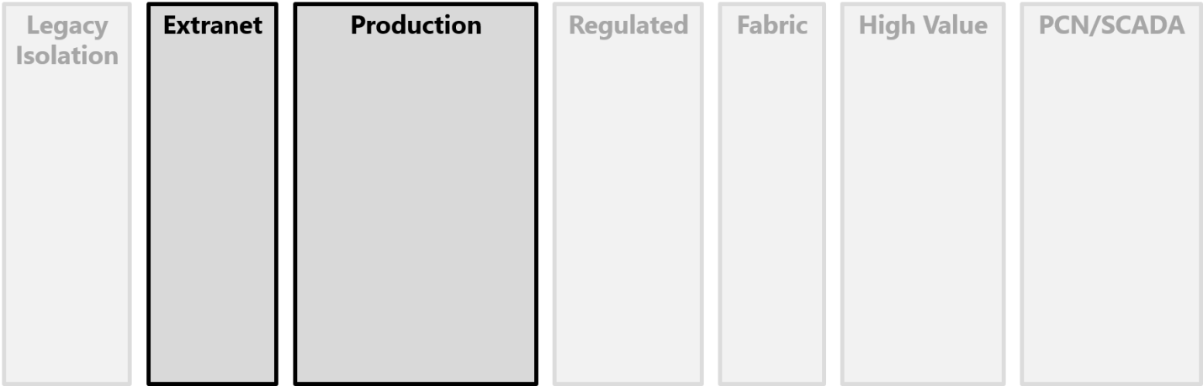
Isolation between security zones
Design security zones to minimize the number of application data flows across the trust boundaries between zones.
Every inter-zone trust boundary must be secured and defended and each application that crosses the boundary incurs security overhead to analyze, protect, and monitor.
Perform a threat modelling exercise for every system and application data flows that crosses the trust boundary between zones, particularly focusing on:

Slide 16
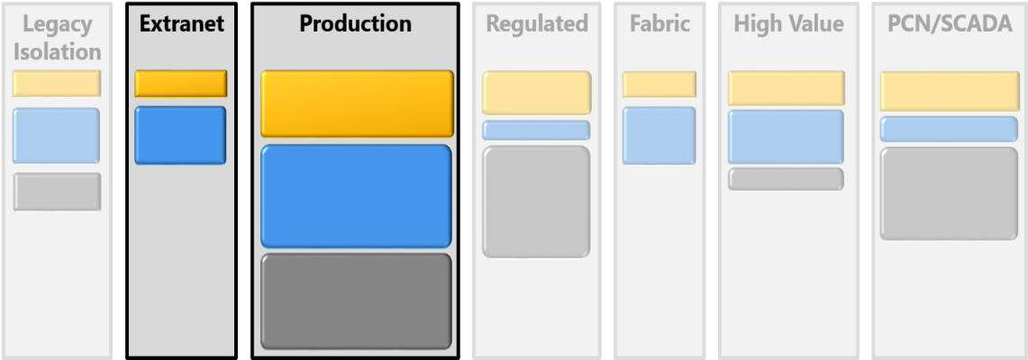
Containment within security zones
Containment within the zone should focus on protecting administrative control of assets in the security zone and ensure that least privilege is applied to access of business-sensitive assets.

Slide 17
Network security
Key driver for Azure network implementation
Network security typically falls into three areas:
Secure/manage traffic flow between applications, their tiers, between different environments, and other services
Secure/manage traffic flow between users and the application
Secure/manage traffic flow between the applications and the Internet
Network security is about building a defense in depth approach

Slide 18
Types of services
IaaS services connected to subnets
PaaS services connected to subnets
Public-facing PaaS services with security lockdown
Public facing PaaS services with TLS access restrictions

Slide 19
Subnet connected defense in depth
PaaS Services
& Virtual Machines
VM
firewall
VM or NIC
NSG
Subnet
NSG
Virtual
Appliances
Load
balancer
DDoS
protection
Internet

Slide 20
PaaS Services with lockdown DiD
PaaS Services
PaaS
lockdown
Load
balancer
DDoS
protection
TLS
Internet

Slide 21
PaaS Services with TLS
PaaS Services
Load
balancer
DDoS
protection
TLS
Internet

Slide 22
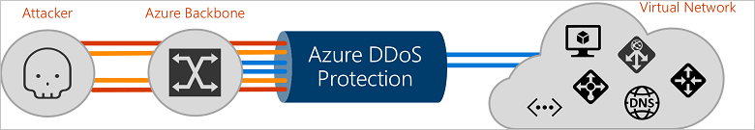
Enhanced Azure DDoS Protection
Preview
Adaptive tuning
DDoS Protection understands your resources and resources configuration
Intelligent traffic profiling auto-learns your application’s traffic overtime
Always-on monitoring & automatic mitigation
Integration with Azure Monitor for analytics and insights
Protection against unforeseen costs of a DDoS attack with alerts and telemetry
Protect against DDoS attacks at Layers 3-7
Can be deployed with Azure App Gateway WAF for advanced protection at Layers 3/4
AppGW WAF helps protect against common Layer 7 attacks identified by the OWASP

Slide 23
Azure security features

Slide 24

Network Security Groups (NSG)
Enables network segmentation and DMZ scenarios
Access control lists and network traffic rules as security group
Security groups associated with Virtual Machines, network interfaces, or Virtual Machine subnets (not GW subnet)
Rules define a 5-tuple
Rules are separated into inbound and outbound rules
Rules applied in order of priority
Network traffic rules updated independent of Virtual Machines
Controlled access to and from Internet
On Premises 10.0/16
Internet
S2S
VPNs
√
√
√
VPN GW
Backend
10.3/16
Mid-tier
10.2/16
Frontend
10.1/16
Virtual Network

Slide 25
Network Security Group models
Two models available for NSGs – At the subnet level and at the VM level.
Subnet-level NSGs: An NSG rule applied to a subnet is logically more like a firewall rule that is applied at the switch, and affects inbound and outbound traffic on every port in the switch. Any VM connected to the switch port would be affected by the NSG rule applied to the subnet.
VM/NI-level NSGs: Apply NSGs at the VM or NIC of a Virtual Machine. This allows greater flexibility in how traffic is filtered.

Slide 26
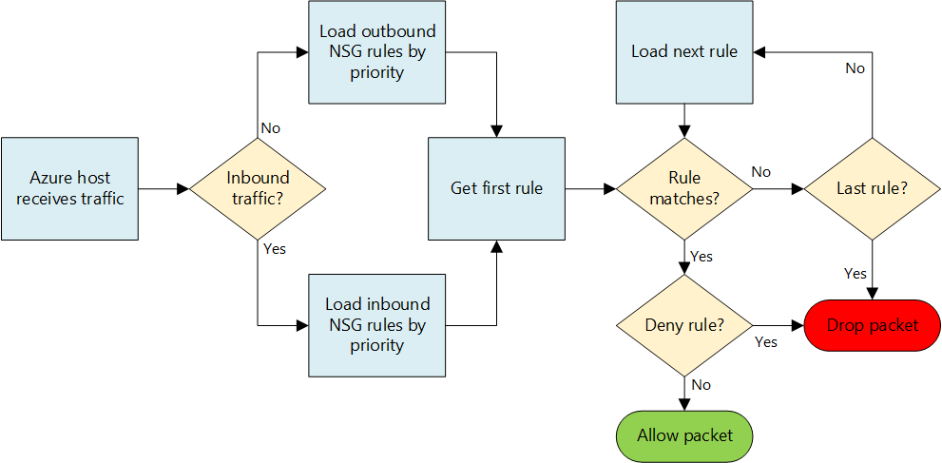
NSG rule process flow

Slide 27
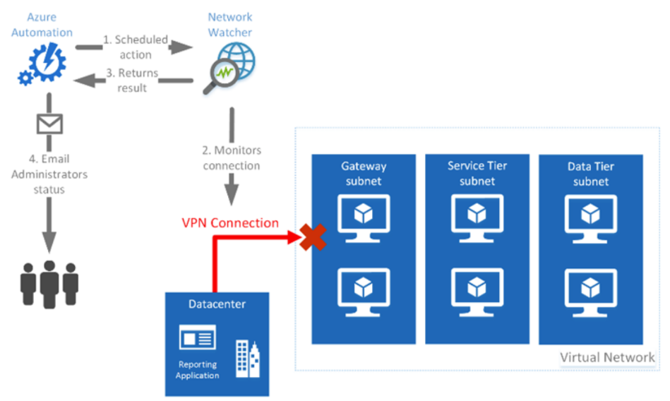
Network Watcher
Enables network performance monitoring and diagnostics service
Capture packet data to, from Azure
View network topology of deployments
Validate traffic flow with “IP flow verify”
Identify misconfiguration of user defined routes
Enable logging of NSG data per NSG
Retrieve configured NSG and effective security rules to determine open ports and assess network security
View usage of network resource against limits of a subscription
Visualize ingested NSG flow log data with PowerBI

Slide 28
Forced tunneling
“Force” or redirect customer Internet-bound traffic to an on-premises site via default route
VPN – done per subnet
ExpressRoute – at BGP-level
Can override with more specific routes via UDR
On-premises
Internet
VPN or
ExpressRoute
Forced tunneled
to gateway
GW
Backend
10.3/16
Mid-tier
10.2/16
Frontend
10.1/16
Virtual Network

Slide 29
Security models for Azure networking
Network Security Group
Access control rules that can be applied to subnets or VMs
Control ingress and egress traffic of a subnet
Control traffic between VMs in a subnet
Control ingress and egress traffic for a single VM
Forced tunneling
Default route for a gateway that send all non-local traffic to customers on premises edge router for processing
When you want to block outbound Internet traffic in a VNet
When you want to block inbound traffic in a VNet
ExpressRoute is implemented at the BGP routing level, provides defense in depth by role separation

Slide 30
Forced tunneling models
Forced tunneling has different implementation requirements and scope depending on the type of Azure connectivity of the Virtual Network.
A Virtual Network that is connected over a S2S VPN connection requires forced tunneling to be defined and configured on a per Virtual Network basis using Azure PowerShell
A Virtual Network that is connected over an ExpressRoute connection requires forced tunneling to be defined at the ExpressRoute circuit and affects all Virtual Networks that are connected to that circuit
A good design practice is to implement network security groups for the subnets of every Virtual Network configured for forced tunneling. This allows you to have an additional layer of network protection

Slide 31
Security models for Azure networking
IPSec
Traffic authentication and encryption at the server level. Requires machine to be domain joined
Want to be able to use policy based traffic encryption and control which servers can communicate with each other
Firewall appliances at the network edge or in traffic flows
Placing a hardware firewall appliance at the customers network edge
Place network appliances between subnet flows
When you want to control ingress/egress traffic between Azure and on-premises
When you want to control traffic between subnets and have full logging

Slide 32
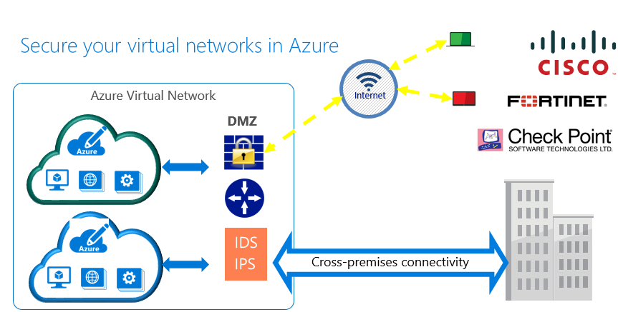
Virtual Appliances – Firewalls, IDS/IPS, VPNs

Slide 33

HA for NVA (ILB any port)
High Availability for NVA through Azure Internal Load Balancer (ILB)
ILB supports any port, any protocol
UDR supports ILB as Next Hop IP address
Failover in less than 15 seconds
Better than AWS! ☺
Any port, any protocol
ILB
DMZ Subnet
UDR
Backend Subnet → ILB
VM1
VM2
Firewall appliance
Back-end subnet

Slide 34
Security models for Azure networking
Firewall appliances – Single NIC
Software-based firewall that can be placed between Virtual Machines and the Internet. Requires all traffic to be routed through the firewall using agents and IPSec typically
When you need additional firewall protection from the Internet. When you want traffic flow control of all VM traffic
When you want logging and monitoring of traffic
Firewall appliances – Dual NIC
Software-based firewall that can be placed between subnets or between a subnet and the Internet
When you need additional firewall protection from the Internet and also need high throughput
Want packet capture and inspection
Want detailed logging

Slide 35
Security models for Azure networking
Web Application Firewalls
Software-based firewall that is used to control ingress traffic from the Internet. Typically a Layer 7 firewall
When you want SSL session termination
When you want session affinity

Slide 36
Logging
NSGs provide control and data plane logging
Control plane – Audit log for change management built into portal
Control plane – Logs for application of rules
Data plane – Flow log visualization capable via integration with PowerBI, Elastic Stack
Virtual Appliances provide control and data plane logging
Control plane is at the appliance level and the portal level
Data plane is typically more capable and real time
Might have to integrate with log consolidation solution

Slide 37
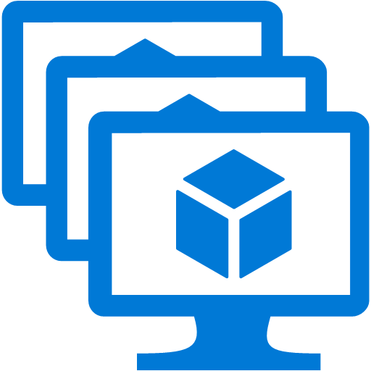
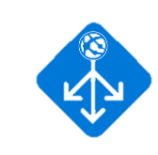
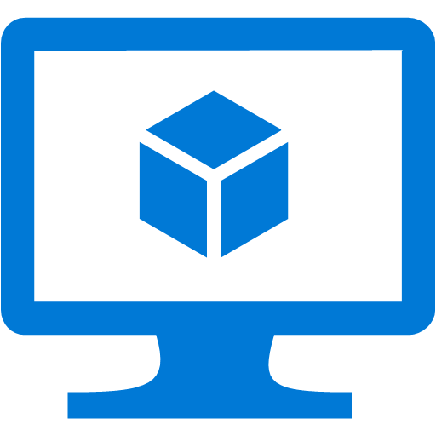
Application gateway – Layer 7 ADC features
Security
SSL termination
Allow/block SSL protocol versions
Session and site management
Cookie-based session affinity
Multi-site hosting
Content management
URL-based routing
Back-end management
Rich diagnostics including access and performance logs
VM Scale Set support
Custom health probes
fabrikam.com
Application Gateway
Videos
contoso.com
contoso.com/video/*
fabrikam.com
Images
contoso.com/images/*

Slide 38

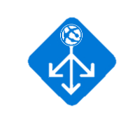
Web Application Firewall (WAF)
Security
Protect applications from web-based intrusions
Built using ModSecurity and Core Rule Set
Availability
Highly available, fully managed
Preconfigured
OWASP* core rule set for most common top 10 web vulnerabilities protection, such as:
SQL Injection
XSS attacks
Customize
Defining custom rules and rule groups
×
Application Gateway
Site 1
XSS attack
Valid request
WAF
Valid request
Valid request
Site 2
×
SQL Injection
L7 LB
*Open Web Application Security Project (owasp.org)

Slide 39
Ingress security approaches

Slide 40
Direct ingress access
Internet access accomplished by exposing the UI tier directly on the Internet
The application needs to be accessed from the Internet and minimal security is required
The application has no connection to corporate resources

Slide 41
Enterprise ingress
Internet access could be blocked using forced tunneling, and all traffic must flow through the corporate Internet-facing security stack and be routed over the corporate backbone via service provider
The application needs to be accessed from the Internet, and high security is required
A security stack that meets requirements cannot be created in Azure

Slide 42
Provider ingress
Internet access could be blocked using forced tunneling, and all traffic must flow through a service providers Internet-facing security stack and be routed over the service provider’s backbone
The application needs to be accessed from the Internet, and high security is required
Internet access is being provided by a service provider that has a backbone connection to Azure

Slide 43
Azure ingress
Internet access accomplished by building a security stack in Azure using Virtual Appliances
Application needs to be accessed from the Internet, and high security is required
Desire to have no dependency on corporate resources
Application requires global load balancing and lowest latency connection

Slide 44
Egress approaches
Use Azure with security stack
Use on-premises via proxy
Use public peering for Azure Services

Slide 45
Key decisions

Slide 46
Virtual Network security decisions
Defense in depth
Leverage NSG at the subnet level for inbound/outbound
Leverage NSG at the NIC level for advanced exceptions
Leverage Virtual Appliances for anywhere you need detailed data plane information or security stacks
Leverage UDR to control traffic flow and targeted default routes

Slide 47
Virtual Network security decisions
Ingress approach
Build an ingress security stack and use Azure as ingress point
Use on premises and ExpressRoute fiber connection with a security stack at the provider
Use on-premises security stack, ExpressRoute, and forced tunneling
Egress approach
Build an egress security stack and use Azure as application egress point
Maintain your current Internet access for clients and on premises services
Determine your security approach to Azure public services

Slide 48
Forced tunneling decisions
Determine how forced tunneling will be used in a design based on the following decisions:
Type of Virtual Network connectivity (S2S or ExpressRoute) – Defines scope of impact
Requirements for direct Internet egress via Azure’s Internet connection – Direct conflict with a business requirement
Security requirements and flexibility – Forced tunneling can provide isolation of network traffic while the connection is up
Connectivity costs – Forcing all traffic back over the S2S or ExpressRoute circuit

Slide 49
Forced tunneling decisions
Recommended
Mandatory
A design that leverages forced tunneling (default route), typically must provide Internet access via different path than inbound than using Azure Internet access
Combine forced tunneling with network security groups to achieve defense in depth of traffic isolation
Optional
Investigate the use of an dual-NIC edge firewall appliance with an extranet subnet as one alternative to NSGs

Slide 50
User-defined routing decisions
Recommended
Ensure that any user defined routes are more specific than ExpressRoute BGP routes or Local Site Network routes, otherwise the UDR will not be used

Slide 51
Network Security Groups decisions
Mandatory
Decide on your NSG priority order as Ingress traffic to the VM, rules are applied at a subnet level, then VM level, and then NIC level. While for egress traffic from the VM, rules are applied at the NIC level, then VM level, and then subnet level
NSGs must be assigned to subnet, VM or NIC for any of the rules to affect traffic

Slide 52
Network Security Groups decisions
Considerations | Decision points
Compliance | Decide whether NSGs comply with PCI or other compliance perspectives with the current logging capabilities of the NSG service
Priority Numbering | Decide on inbound and outbound priority rules numbering and plan to leave a blank number space between rules as Inbound and outbound rules are independent
Default Rules | Choose to define a rule that has a priority number in the 4000 range so that it’s possible to override the default values and allow as many additional rules as possible
Port Numbers | Decide on specifying port ranges (e.g. 1024-1048) in the rule definition and note that you cannot specify random port numbers consecutively (e.g. 1024, 1036, 30000)

Slide 53
Network Security Groups decisions
Considerations | Decision points
Targeting | Decide what to target with NSGs based on NSG’s limits: Choose to target by VM when the number of systems which require this ruleset (both immediately and in the future) is unknown Choose to target by subnet when the rulesets are defined by role and the number of systems which the NSG will be expected to apply is well known and appropriate subnet sizes can be determined for these systems
Precedence | Decide on the precedence of NSGs before deploying onto existing NSGs at the subnet and VM levels. Consider the following: Denial at Subnet takes precedence over allow at VM or NIC level Denial at VM level takes precedence over allow at the NIC level or the subnet level Denial at NIC level takes precedence over allow at VM or subnet level

Slide 54
Endpoints decisions
Recommended
Mandatory
Understand that public endpoints are not required unless you need inbound access from the Internet
Only enable public endpoints if inbound Internet is the only way to achieve that communication
Use P2S, S2S, or ExpressRoute to RDP or access the PowerShell interfaces to a machine versus using a public endpoint

Slide 55
Appendix

Slide 56
NSG tags
Tag | Description
VIRTUAL_NETWORK (ASM) VirtualNetwork (ARM) | This default tag denotes all of your network address space. It includes the Virtual Network address space (IP CIDR in Azure) and all connected on-premises address spaces (local networks). It also includes Virtual Network-to-Virtual Network address spaces.
AZURE_LOADBALANCER (ASM) AzureLoadBalancer (ARM) | This default tag denotes the load balancer for the Azure infrastructure. This translates to an IP address for an Azure datacenter where the health probes originate. This is needed only if the Virtual Machine or set of Virtual Machines associated with the Network Security Group is participating in a load balanced set. Note this is not the actual load balancer IP address.
INTERNET (ASM) Internet (ARM) | This default tag denotes the IP address space that is outside the virtual network and reachable by public Internet. This range includes the public IP space that is owned by Azure. If you use this tag for outbound restrictions, you potentially will not be able to access an Azure PaaS service unless you have a higher priority rule that grants access to that service.

Slide 57
Default NSG rules
Inbound
Outbound
Description | Priority | Source Address | Source Port | Destination Address | Destination Port | Protocol | Action
Allow Virtual Network inbound | 65000 | VIRTUAL_NETWORK | * | VIRTUAL_NETWORK | * | * | Allow
Allow Azure load balancer inbound | 65001 | AZURE_LOADBALANCER | * | * | * | * | Allow
Deny all inbound | 65500 | * | * | * | * | * | Deny
Description | Priority | Source Address | Source Port | Destination Address | Destination Port | Protocol | Action
Allow Virtual Network outbound | 65000 | VIRTUAL_NETWORK | * | VIRTUAL_NETWORK | * | * | Allow
Allow Internet outbound | 65001 | * | * | INTERNET | * | * | Allow
Deny all outbound | 65500 | * | * | * | * | * | Deny

Slide 58
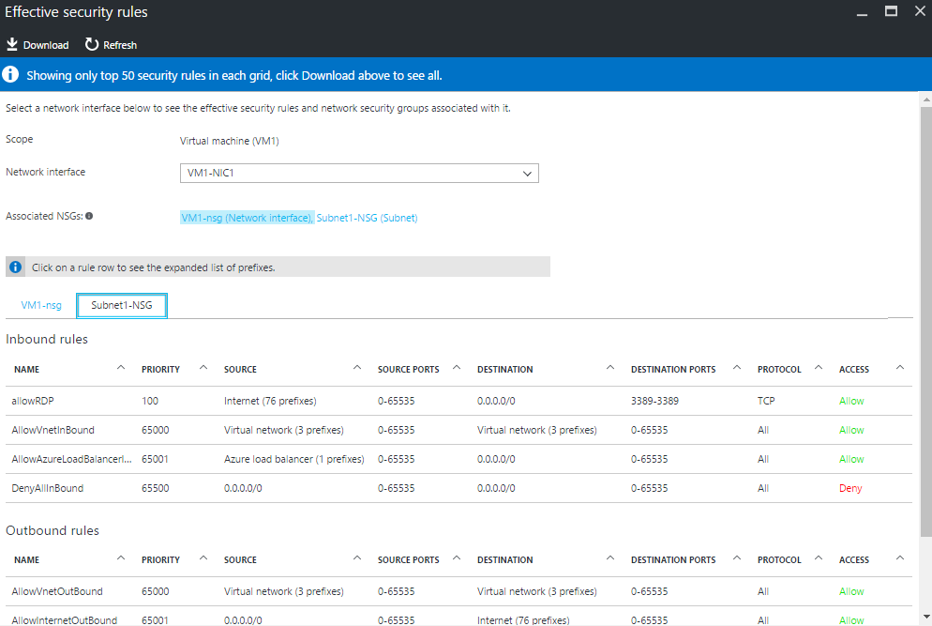
Who is blocking me – Troubleshooting NSG rules
Effective rules applied on the NIC
Consolidated view of NIC and subnet NSGs
Expanded system tags

Slide 59
Network Virtual Appliance models
Network Firewall
Leverages multi-NIC VM with layer 3 routing support to enable a network firewall between multiple subnets in Azure
Control outbound traffic flow to the Internet from an application tier
Control inbound traffic flow from the Internet to a UI tier of an application
Control traffic flow between two subnets in Azure
Collect detailed packet captures or network logs of traffic flowing through the appliance

Slide 60
Network Virtual Appliance models
Load balancer
Provides Layer 4 or Layer 7 load balancing
When a load balancer with more features that the Azure load balancer is required
When detailed logging is required
When SSL termination is required

Slide 61
Network Virtual Appliance models
VPN
Provides VPN services for remote access or S2S connectivity
Does not support ER connection HA is not supported yet
Not a recommended replacement for S2S connectivity

Slide 62
Network Virtual Appliance models
Security appliance
Intrusion Detection Appliance
When attempting to create a security stack to manage inbound Internet traffic
When advanced security monitoring and mitigation solution is needed

Slide 63

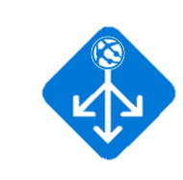


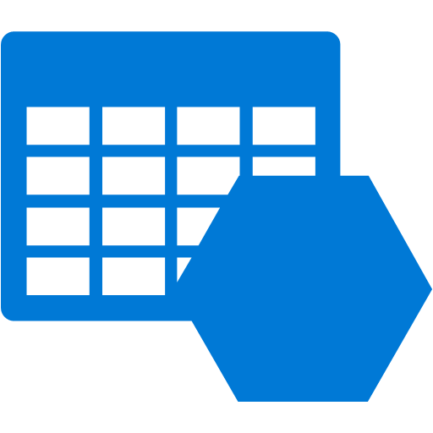
Web Application Firewall (WAF)
Provisioning
WAF SKU for Application Gateway
Available for public and private endpoints
Detection and prevention modes
Real-time monitoring
WAF logs integrated with Azure Monitor
Azure Security Center coming soon
Manage
Portal, PowerShell, SDK supported
Application Gateway
Portal
WAF
PowerShell
L7 LB
Recommends
Alerts
WAF logs
Azure Security Center
Azure Insights
Storage

Slide 64
Example approaches with Virtual Appliances

Slide 65
Example multi-NIC NVA scenarios

Slide 66
Example multi-NIC NVA scenarios

Slide 67
Example multi-NIC NVA scenarios

Slide 68
Example multi-NIC NVA scenarios

Slide 69
Example multi-NIC NVA scenarios

Slide 70
Example multi-NIC NVA scenarios

Slide 71
Example multi-NIC NVA scenarios

Slide 72
Other considerations
NSGs are required
Certificates for SSL/TLS termination
RBAC design for management of the security objects
Hybrid IaaS and PaaS solutions

Slide 73
Example approaches with Azure security

Slide 74



Securing VNet inbound traffic – Azure VIP
Internet
NSG cannot be directly applied on Azure load balancer or VIP
To filter inbound internet traffic on load-balanced endpoint, apply NSG on VM’s private port
Sample inbound NSG rules for DMZ:
Azure LB
VIP:1234
DMZ
DIP1:80
DIP2:80
NSG
Priority | Access | SrcIP | SrcPort | DestIP | Dest Port | Protocol
100 | Deny | INTERNET | * | DIP1 | 80 | TCP
200 | Allow | INTERNET | * | * | 80 | TCP
300 | Deny | INTERNET | * | * | * | TCP
FrontEnd Subnet (10.0.1.0/24)
VIRTUAL NETWORK
(10.0.0.0/16)

Slide 75
Securing VNet inbound traffic – Public IPs
Public IP on a NIC opens all ports to Internet
Access restricted via NSG
Default NSG rule blocks all inbound traffic
Required ports should be opened via NSG rules
ARM portal:
VMs get a public IP and NSG, by default
Portal adds NSG rules to open RDP\SSH for connectivity
Additional ports should be opened via NSG rules
ARM PowerShell
VM gets no public IP or NSG, by default
Manually add the Public IP and NSG + Rules
Priority | Access | SrcIP | SrcPort | DestIP | Dest Port | Protocol
100 | Allow | INTERNET | * | * | 3389 | TCP
65500 (Default) | Deny | INTERNET | * | * | * | *
Public IP
NSG
Azure VM
Subnet

Slide 76

Securing VNet inbound traffic – On-prem or private IPs
Azure (VNet-B)
(10.1.0.0/16)
Default NSG rule to allow all inbound traffic via VPN Gateway
Traffic from specific VNets (on-prem or Azure) could be restricted via NSG rules
Source IP : Originating subnet\VM\NIC
Gateway subnet CIDR should not be used
Sample NSG associated with Subnet1(SB_NSG):
GW
S2S
Gateway Subnet(10.0.2.0/24)
SB_NSG
S2S/ER
GW
Priority | Access | SrcIP | SrcPort | DestIP | Dest Port | Protocol
100 | Deny | 10.1.0.0/16 | * | * | 3389 | TCP
65000 (Default) | Allow | VIRTUAL_NETWORK | * | VIRTUAL_NETWORK | * | *
On-prem
(10.2.0.0/16)
Subnet1(10.0.1.0/24)
VIRTUAL NETWORK
(10.0.0.0/16)

Slide 77

Securing VNet outbound traffic – NVAs\UDR
Internet
Azure LB
Forward all outbound traffic to a NVA (say, 3rd party firewall) using UDR
NVAs can also be used to filter out traffic within subnets
Limitation: NVA could become single point of failure
Gotcha:
Single NIC NVA should be deployed in a separate subnet from originating traffic. Deploying in the same subnet will cause an infinite loop.
WAF
10.0.0.4
Security Subnet
(10.0.0.0/24)
Route Table:
NextHop 10.0.0.4
NSG
NSG
Route Table:
NextHop 10.0.0.4
Front-end Subnet
(10.0.1.0/24)
Back-end Subnet
(10.0.2.0/24)
VIRTUAL NETWORK
(10.0.0.0/16)

Slide 78
Securing VNet outbound traffic
Internet
Forced-tunneling S2S
“Force” or redirect customer Internet-bound traffic to an on-premises site. Can be done on a subnet basis
Auditing and inspecting outbound traffic from Azure
Limitation: Redirects all internet-bound traffic including Azure 1st party services(e.g., storage\SQL)
Solve with split-tunneling:
Filter out 1st party traffic from going back to on-prem by whitelisting Azure IP ranges in UDR
Azure LB
Gateway Subnet(10.0.3.0/24)
WAF
10.0.0.4
S2S
Security Subnet
(10.0.0.0/24)
GW
Route Table:
Dest 0/0
NextHop VPN Gateway
On-prem
(10.2.0.0/16)
NSG
NSG
Front-end Subnet
(10.0.1.0/24)
Back-end Subnet
(10.0.2.0/24)
VIRTUAL NETWORK
(10.0.0.0/16)

Slide 79
Securing VNet outbound traffic
Internet
Forced-tunneling ExpressRoute
“Force” or redirect customer Internet-bound traffic to an on-premises site via BGP. Affects all VNets connected to the ExpressRoute circuit
Limitation: Redirects all internet-bound traffic including Azure 1st party services (e.g., storage\SQL)
Solve with public peering:
Enable public peering on ER circuit and allow 1st party traffic
Azure
Forced Tunneling
Dest 0.0.0.0/0
Gateway Subnet(10.0.3.0/24)
Private
MSEE
ExpressRoute
ExpressRoute
NSG
NSG
Public
NSG
NSG
SP
Front-end Subnet
(10.0.1.0/24)
Back-end Subnet
(10.0.2.0/24)
Router
On-prem
(10.2.0.0/16)
Internet
VIRTUAL NETWORK
(10.0.0.0/16)

Slide 80
Securing intra-VNet traffic
Internet
NSG Data-plane:
Effective rules applied on VM\NIC to filter traffic in\out of that VM\NIC
Scenario: Malicious user gains access to front-end subnet but cannot reach back-end subnet
NSG Control-plane:
RBAC with NSGs: Control users applying NSG policies
Example: Allow access to back-end NSGs only to administrators
Monitoring NSG usage
Operational logs
To monitor list of operational events taken by a user on a given NSG
Control-Plane(Event\Counter) logs
To monitor NSG rules applied and how frequently
Port 443
Azure LB
NSG
Front-end Subnet
(10.0.0.0/24)
NSG
Port 443
NSG
App Subnet
(10.0.1.0/24)
Port 1433
Back-end Subnet
(10.0.2.0/24)
VIRTUAL NETWORK
(10.0.0.0/16)
VIRTUAL NETWORK
(10.0.0.0/16)
Deny
Allow

Slide 81

VNet connectivity
Dedicated 1st party services
Dedicated single-tenant 1st party services can be deployed into a Azure VNet
Supported Services:
Redis Cache
HDInsight
App Service Environment(ASE)
Application Gateway
Central Management:
Deploy in a VNet and access from all other VNets via VPN Gateway\ER
Azure AD to provide SSO for on-prem users
Internet
Azure AD
Azure LB
Azure (VNet-B)
(10.1.0.0/16)
NSG
GW
S2S
RedisCache Subnet
(10.0.0.0/24)
Gateway Subnet
(10.0.3.0/24)
NSG
NSG
S2S/ER
GW
On-prem
(10.2.0.0/16)
Front-end Subnet
(10.0.1.0/24)
Back-end Subnet
(10.0.2.0/24)
VIRTUAL NETWORK
(10.0.0.0/16)
VIRTUAL NETWORK
(10.0.0.0/16)

Slide 82
VNet Service Endpoints
Internet
Multi-tenant 1st party services
Generally, Azure 1st party endpoints are open to the Internet
A malicious user (Admin with account keys) can copy blob URI and access contents from a home location
In preview:
Ability to tie Azure Storage Account\SQL DB to a given VNet
Azure LB
Deny Access
NSG
NSG
Azure
Storage/ SQL
(ACL to VNet)
Allow Access
VNet only
Front-end Subnet
(10.0.1.0/24)
Back-end Subnet
(10.0.2.0/24)
VIRTUAL NETWORK
(10.0.0.0/16)
VIRTUAL NETWORK
(10.0.0.0/16)

